Slide 1
Abstractive Text Summarization
Guided By: Submitted By:
Mr. Krishnanjan Bhattacharjee
Aakash Mahesha (210940128001)
Aakash Negi (210940128002)
Abhijit Das (210940128003)
Ganesh Panchal (210940128016)
Aboli Kesugade (210940128024)

Slide 2
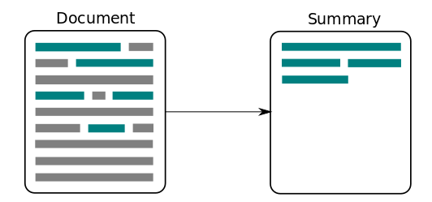
Text Summarization

Slide 3
Definition Of Text Summarization
Goal: Reducing the text with the help of computer program in order to create a summary that retains the most important points of the original text
Summarization Application:
Summaries of email threads
Summaries of Conversations
Summaries of big Paragraphs

Slide 4
Technology Used:
Python
Jupyter Notebook
Machine Learning Algorithms
Hugging face transformers
Flask and Flask_RESTful Frameworks
Docker

Slide 5
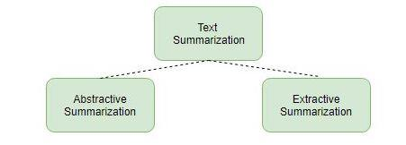
Text Summarization Types
Extractive Summarization:Creates a summary from phrases or sentences in the source documents
Abstractive Summarization:Expresses the ideas of the source Document using different words

Slide 6
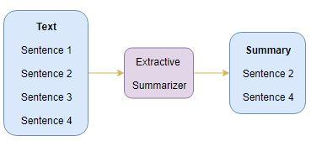
Extractive Summarization

Slide 7
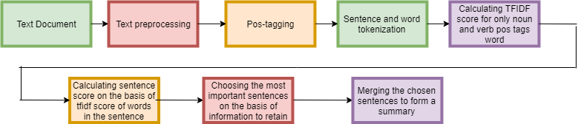
Flow of extractive summarization using tf-idf

Slide 8
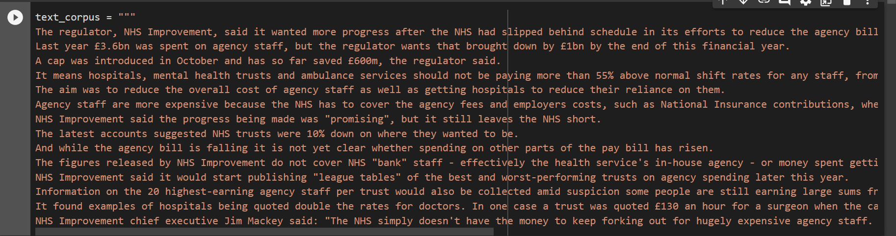
Models Created:
Input of tf-idf model

Slide 9
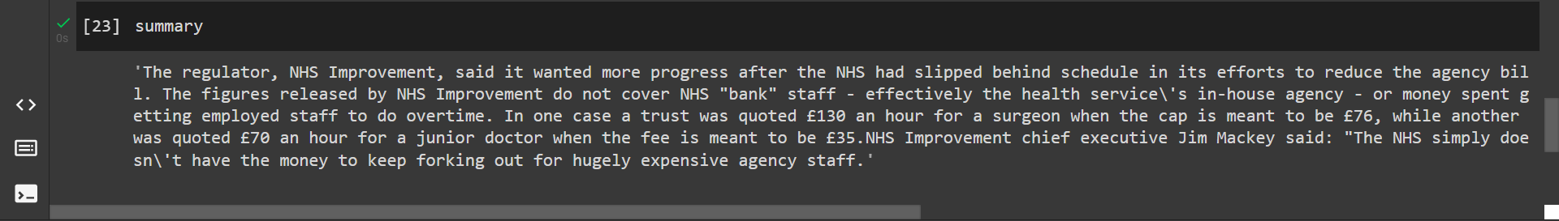
Summary generated by tf-idf

Slide 10
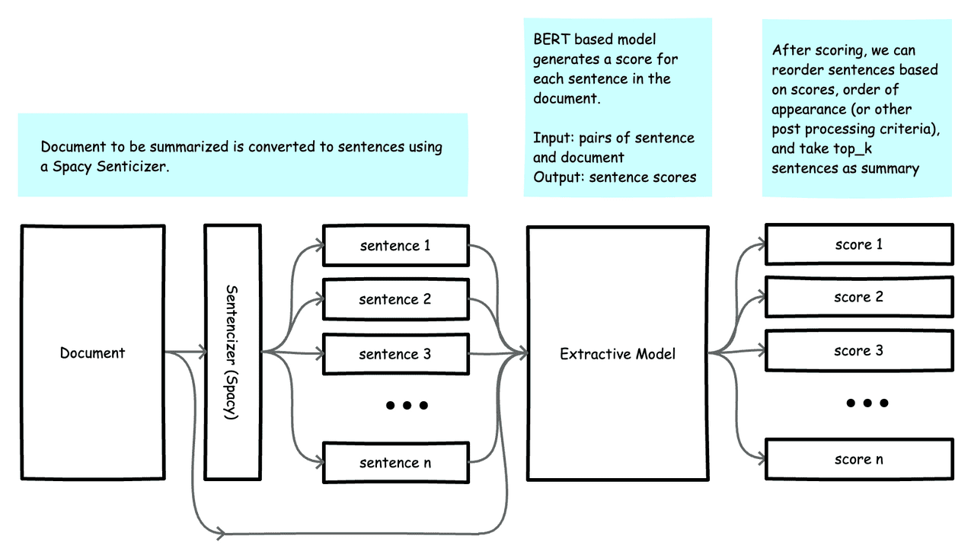
2) Extractive Summarization Using Bert_Sum:

Slide 11
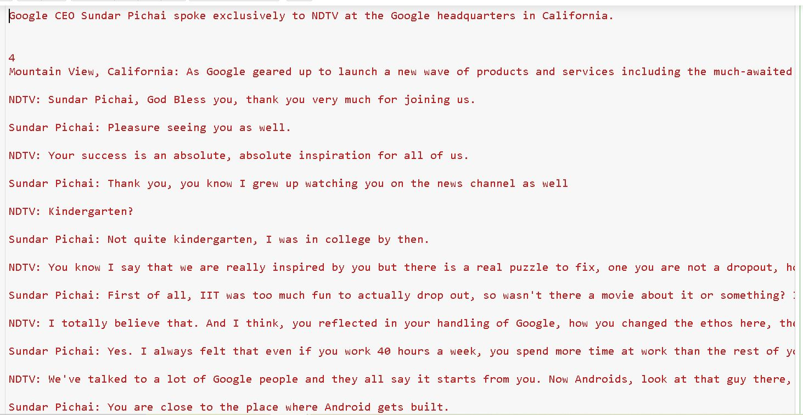
Input:

Slide 12
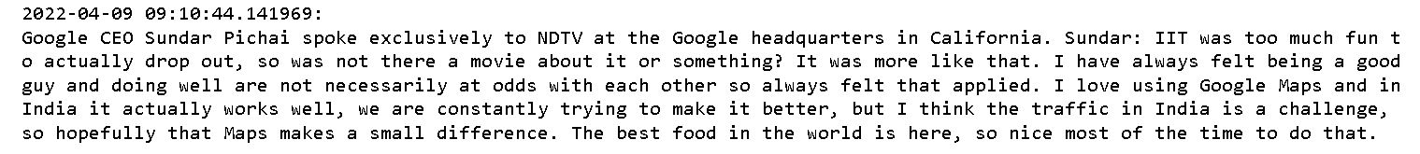
Output

Slide 13
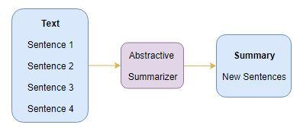
Abstractive Text Summarization

Slide 14
Abstractive Summarization using LSTM model.

Slide 15
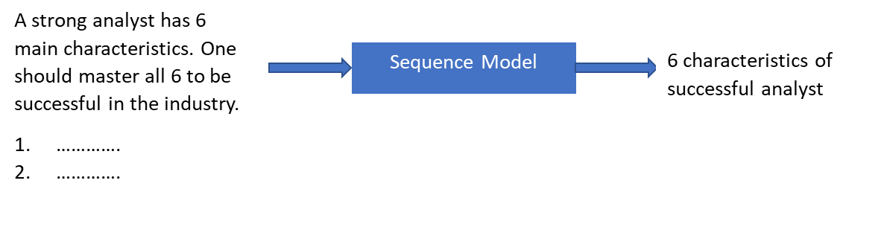
Sequence to Sequence Models:
Sequence model learns the probability of occurrence of an element based on previous elements.
Abstractive Text Summarization:

Slide 16
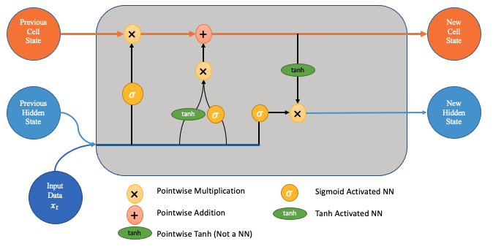
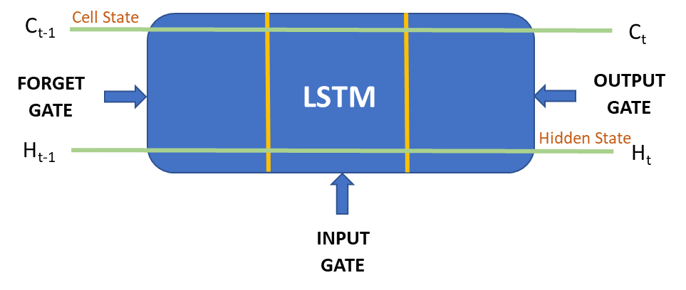
Long Short Term Memory (LSTMs)
LSTMs are a special type of RNNs with an additional state 'cell state'
Used to make adjustment in the information flow.
With cell state, model can remember or forget the learnings more selectively

Slide 17
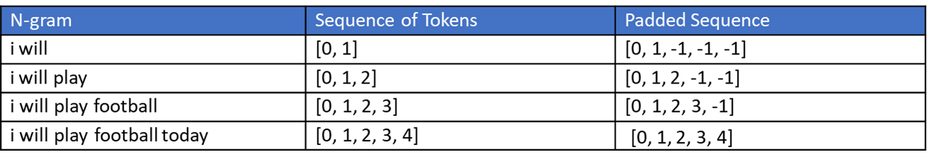
Dataset Preparation
Create Word Index
Text: I will play football today
Tokens: [I, will, play, football, today]
Token Index: [0, 1, 2, 3, 4]
Convert text into sequence of tokens
N grams: Sequence of Tokens

Slide 18
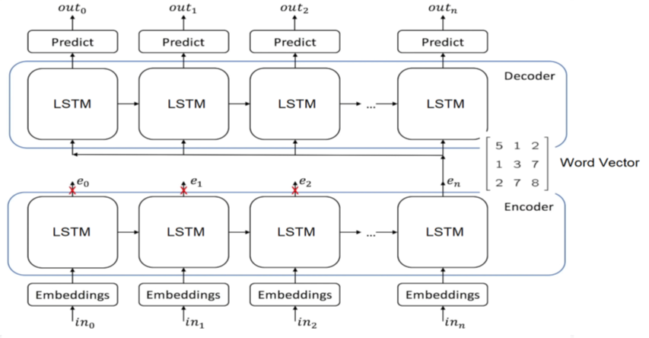
Encoder & Decoder Architecture

Slide 19
Introduction to google pegasus model
Limitations of LSTM network:
LSTM takes longer time to train.
LSTM does not generate appropriate abstractive summarization as compared to transformer models.
PEGASUS: (Pre-training with Extracted Gap-sentences for Abstractive Summarization)
pre-training Transformers with self-supervised objectives on large text.
It is evaluated on 12 downstream datasets measured by ROUGE scores.
Model summaries shows that it can achieve human performance on multiple datasets.

Slide 20
Abstractive Dialogue Summarization using Transformers

Slide 21
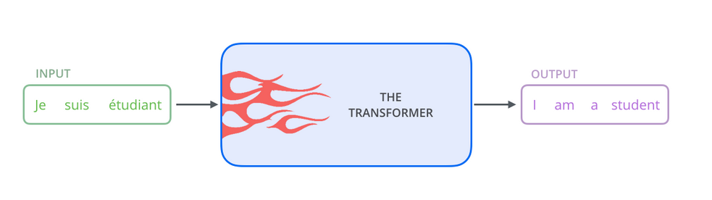
What are Transformers?
Started a new era in NLP in 2017. It completely replaced RNNs and LSTMs.
Transformers are models that can translate text, write stories and summarize large text data.
Transformers could be very efficiently parallelized which meant we could train some really big models. Example: GPT3 is a text generation model that was trained on 45TB of text data.

Slide 22
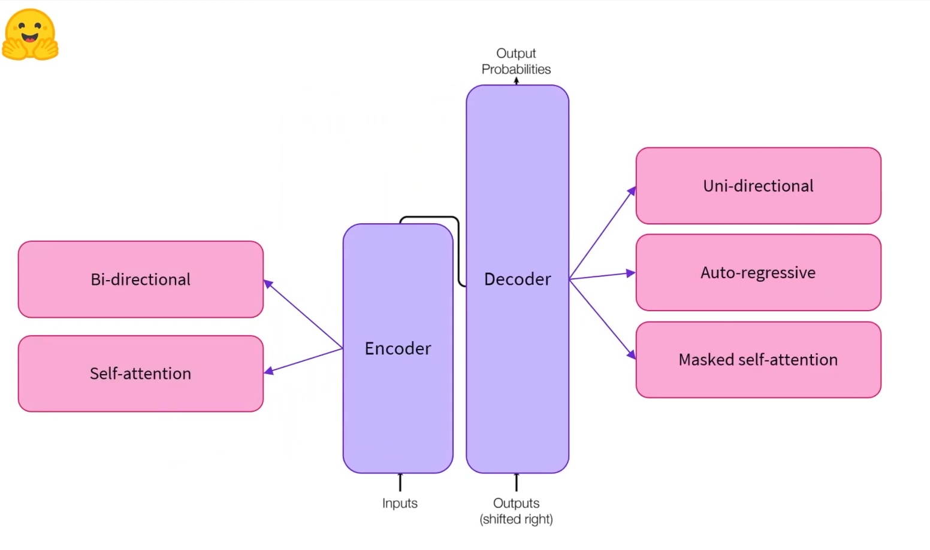
The encoder accepts input that represents texts and converts them into numerical representations which are known as embeddings. Every embedding generated also takes into account the words that are around it. Example:BERT
The decoder can be used for most of the same tasks as the encoder albeit with generally a little loss of performance. The main difference between them is that when text is given as an input to the decoder, it generates an embedding(vector) but doesn’t take into consideration the meaning or context of the word. Example: GPT-2
The encoder-decoder model uses both of these architectures together. The encoder part takes care of understanding the sequence and the decoder part takes care of generating a sequence according to the understanding of the encoder. Example: T-5,Pegasus

Slide 23
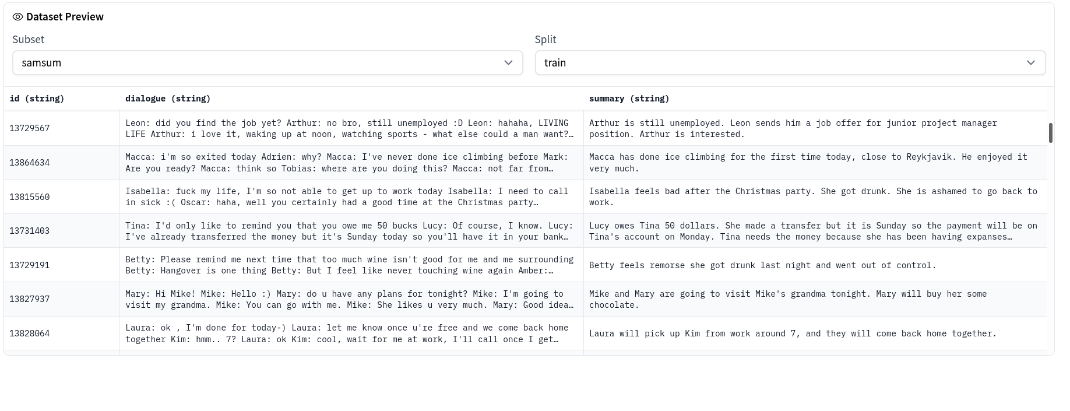
Dataset

Slide 24
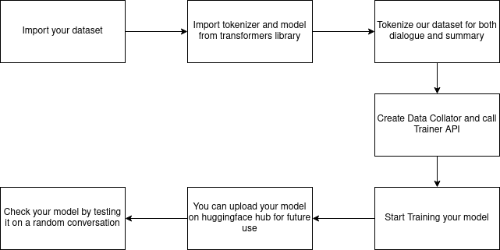
Workflow of our model

Slide 25
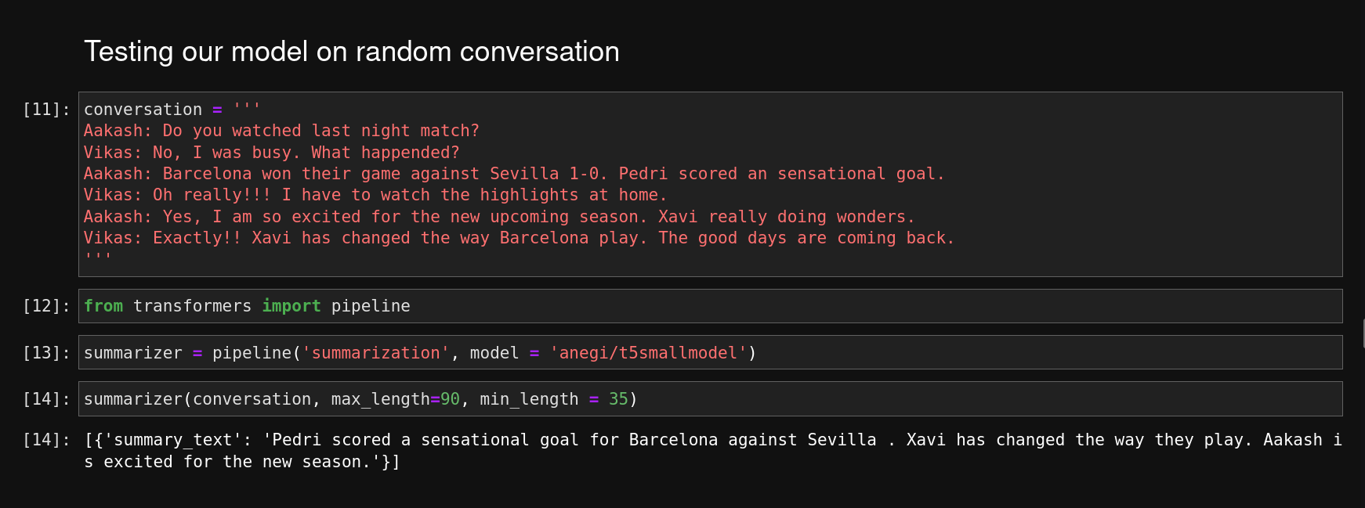
Results

Slide 26
Implementation and Deployment
Using Flask Framework and Docker Container Technology

Slide 27

Web Application Using Flask Framework
Flask is a micro web framework written in Python.
It is classified as a microframework because it does not require particular tools or libraries.

Slide 28
Flow Structure of Flask Web Application
Send the form data
2. Data is sent for processing
HTML
Flask
Python
4. Result is sent back to html page
3. Result is generated

Slide 29
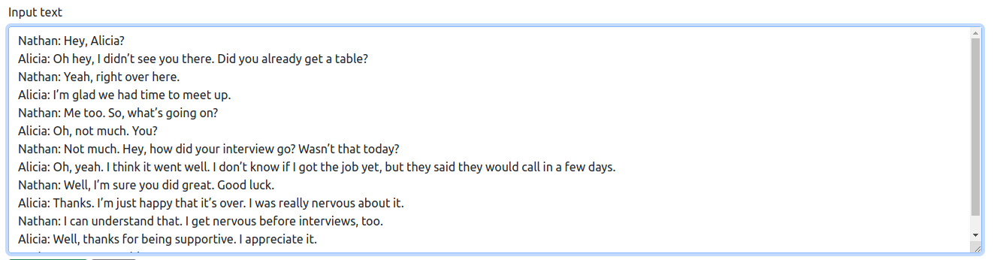
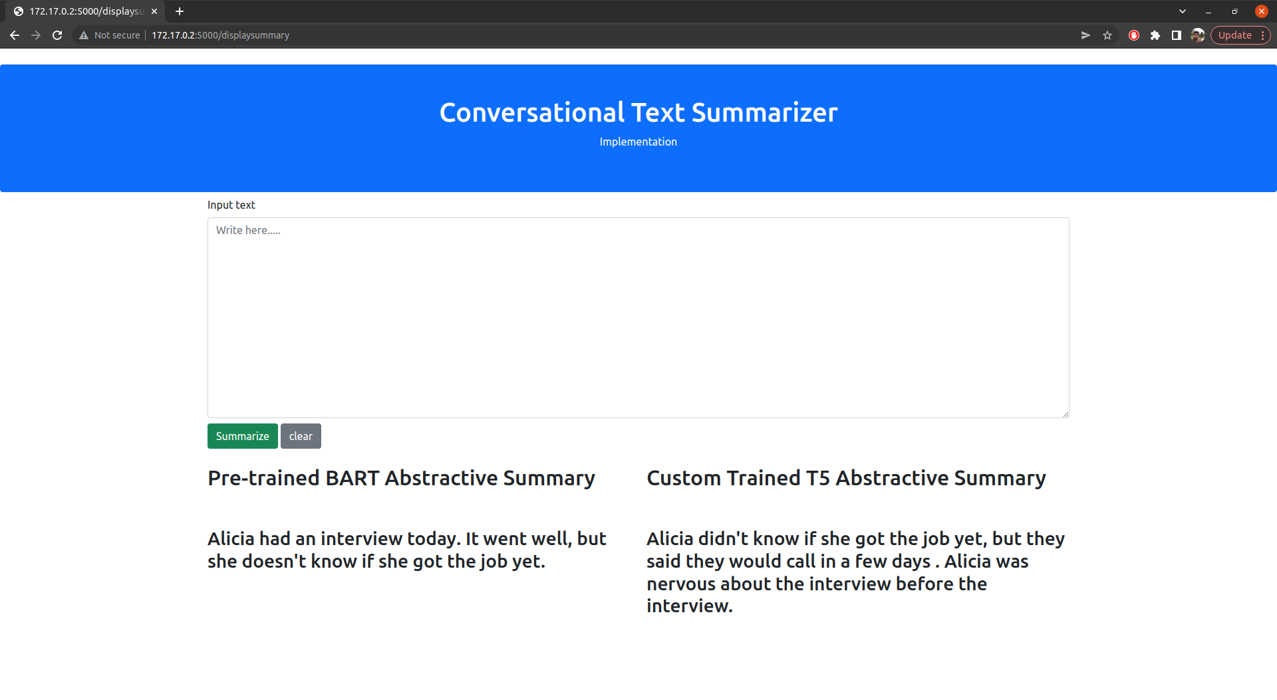
Result

Slide 30

Docker Containers
Docker is a software platform for building applications based on containers—small and lightweight execution environments that make shared use of the operating system kernel but otherwise run in isolation from one another.

Slide 31
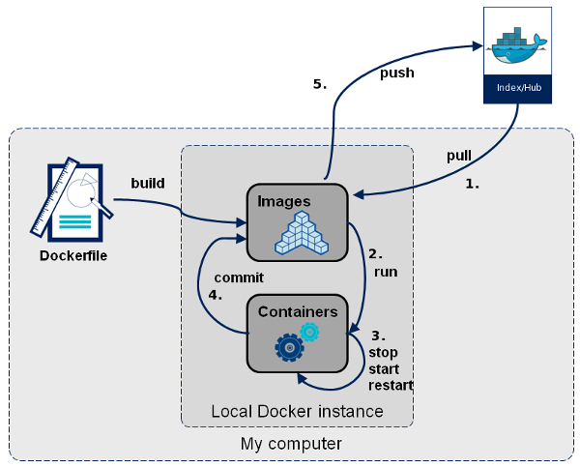
Docker Workflow

Slide 32
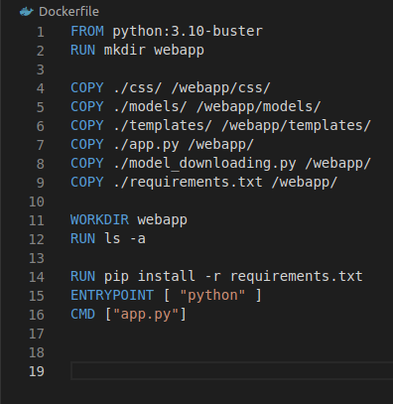
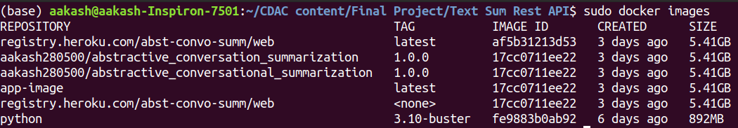
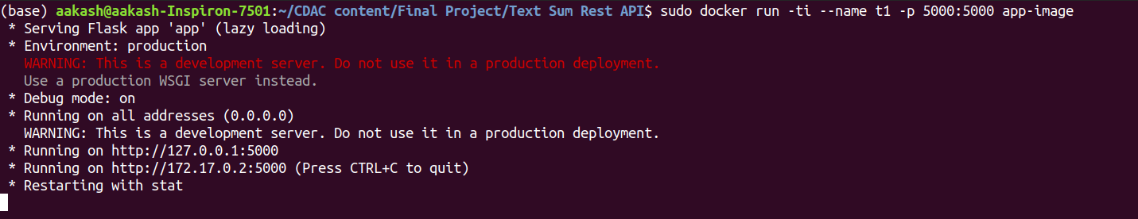
Result

Slide 33
REST API using Flask_RESTful
REST is an architectural style that defines a set of constraints to be used for creating web services.
REST API is a way of accessing web services in a simple and flexible way without having any processing.
Flask_RESTful, which is an extension for Flask that adds support for quickly building REST API.

Slide 34
Flask_RESTful Workflow
An HTTP request(get or post) is sent to the server on which the REST API is running. Along the with the request the input data is sent to the server.
At the server, the data is retrieved from the JSON object.
Based on the respective request, the processing of the data is done on the server.
Finally the result is returned in the form of JSON object

Slide 35
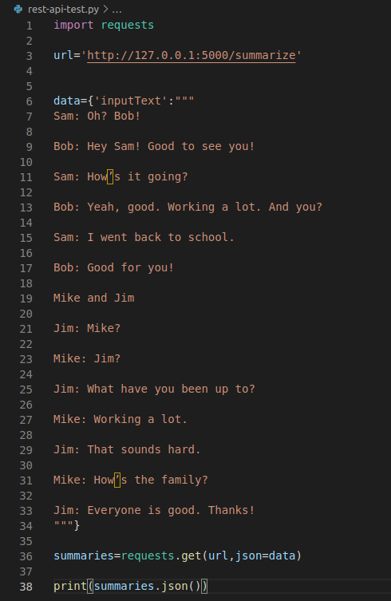

Result

Slide 36
THANK YOU

